Slide 1
Evolutionary Biology
BIOCHEM 3BP3

Slide 2
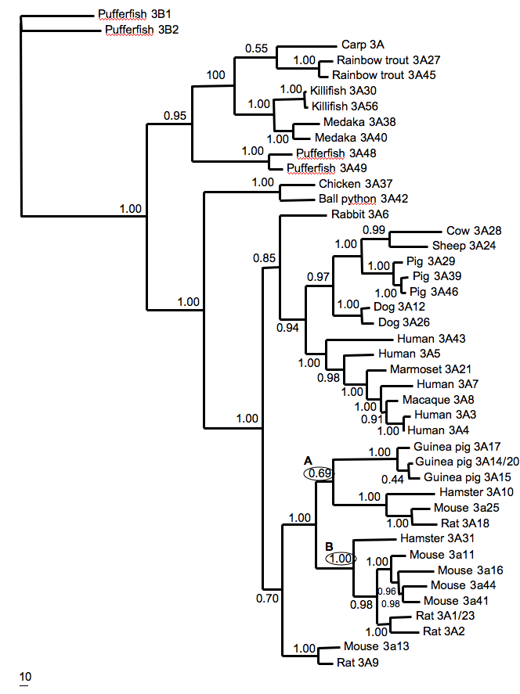
An Example: CYP3A Phylogeny
McArthur et al. 2003. J. Mol. Evol. 57: 200-211.

Slide 3
An Example: CYP3A Phylogeny
Outgroup choice is important
McArthur et al. 2003. J. Mol. Evol. 57: 200-211.

Slide 4
An Example: CYP3A Phylogeny
Outgroup choice is important
Trees can reflect gene duplication
McArthur et al. 2003. J. Mol. Evol. 57: 200-211.

Slide 5
An Example: CYP3A Phylogeny
Outgroup choice is important
Trees can reflect gene duplication
Trees can reflect speciation
McArthur et al. 2003. J. Mol. Evol. 57: 200-211.

Slide 6
An Example: CYP3A Phylogeny
Outgroup choice is important
Trees can reflect gene duplication
Trees can reflect speciation
Trees can be a combination of gene trees and species trees
McArthur et al. 2003. J. Mol. Evol. 57: 200-211.

Slide 7
An Example: CYP3A Phylogeny
Outgroup choice is important
Trees can reflect gene duplication
Trees can reflect speciation
Trees can be a combination of gene and species trees
Trees should include confidence estimates
McArthur et al. 2003. J. Mol. Evol. 57: 200-211.

Slide 8
An Example: CYP3A Phylogeny
Outgroup choice is important
Trees can reflect gene duplication
Trees can reflect speciation
Trees can be a combination of gene and species trees
Trees should include confidence estimates
Trees should include estimates of evolutionary distance
McArthur et al. 2003. J. Mol. Evol. 57: 200-211.

Slide 9
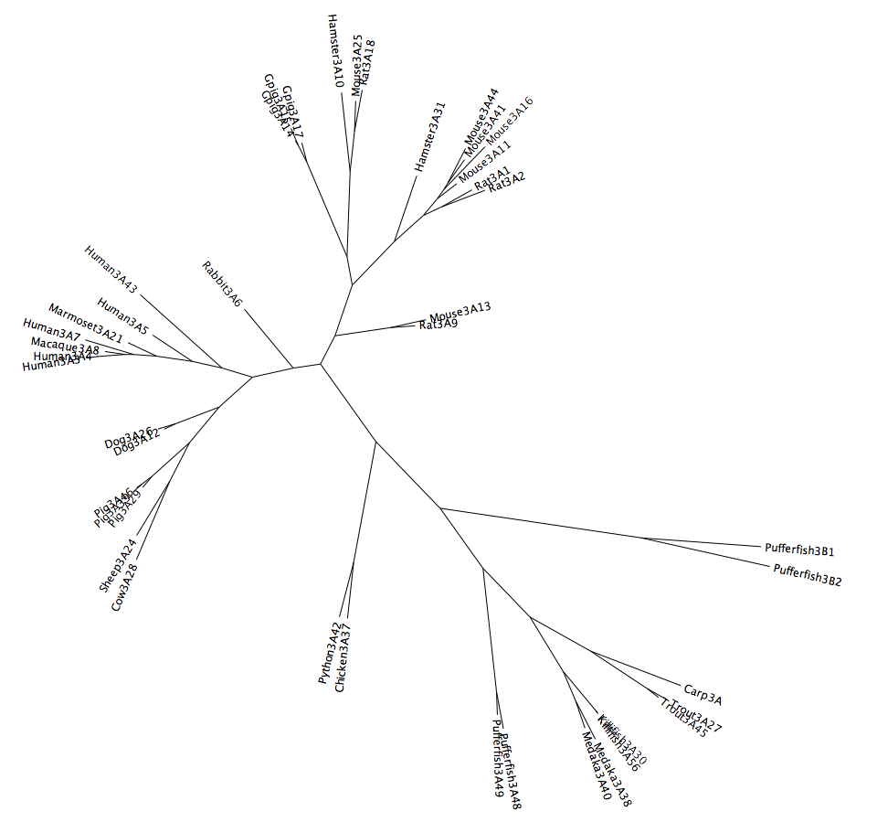
An Example: CYP3A Phylogeny
Branch lengths are a function of time and rate of evolution – evolutionary clocks are local (aka “soft)
McArthur et al. 2003. J. Mol. Evol. 57: 200-211.

Slide 10
Substitution & Rates of Evolution
Ancestral Sequence

Slide 11
Substitution & Rates of Evolution
Ancestral Sequence
t
t = time
Gene Duplication
Sequence 1
Sequence 2

Slide 12
Substitution & Rates of Evolution
A
No change
t
t = time
Gene Duplication
A
A

Slide 13
Substitution & Rates of Evolution
A
Single Substitution
t
t = time
Gene Duplication
C
A

Slide 14
Substitution & Rates of Evolution
A
Unequal rates of evolution
False sequence similarity!
Multiple Substitutions
t
t = time
Gene Duplication
C
C
One of the primary issues with phylogenetics is to determine history despite multiple substitutions.

Slide 15
Key Issues of Phylogenetics
1
How do we find homologous sites?
2
How do we model substitution?
3
How do we search for the best tree?

Slide 16
Key Issues of Phylogenetics
1
How do we find homologous sites?
HOMOLOGOUS
A homologous trait is shared between two species because they inherited it from a common ancestor.
Information from homologous traits can be used to infer evolutionary relationships.
Non-homologous traits do not reflect evolutionary history but instead convergence. They can mislead inference of evolutionary relationships. Example: octopus eye versus human eye.

Slide 17
Multiple Sequence Alignment
Alignment of highly similar sequences is easy – each column is assumed to reflect a homologous position in the protein
Blocks of identical sequence with infrequent gaps
Substitutions conservative (i.e. leucine versus isoleucine)

Slide 18
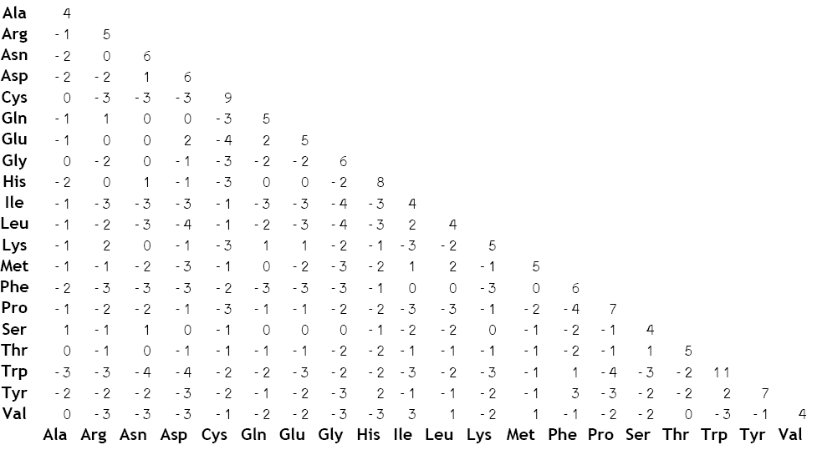
Multiple Sequence Alignment
Just like BLAST, alignment software like Clustal uses BLOSUM, PAM, or other empirical substitution matrices to model conservative amino acid substitutions.

Slide 19
Multiple Sequence Alignment
Clustal and related methods can handle up to ~70% sequence divergence when BLOSUM or other matrices are used. Insertion and deletions of amino acids (INDELs) are the challenge.

Slide 20
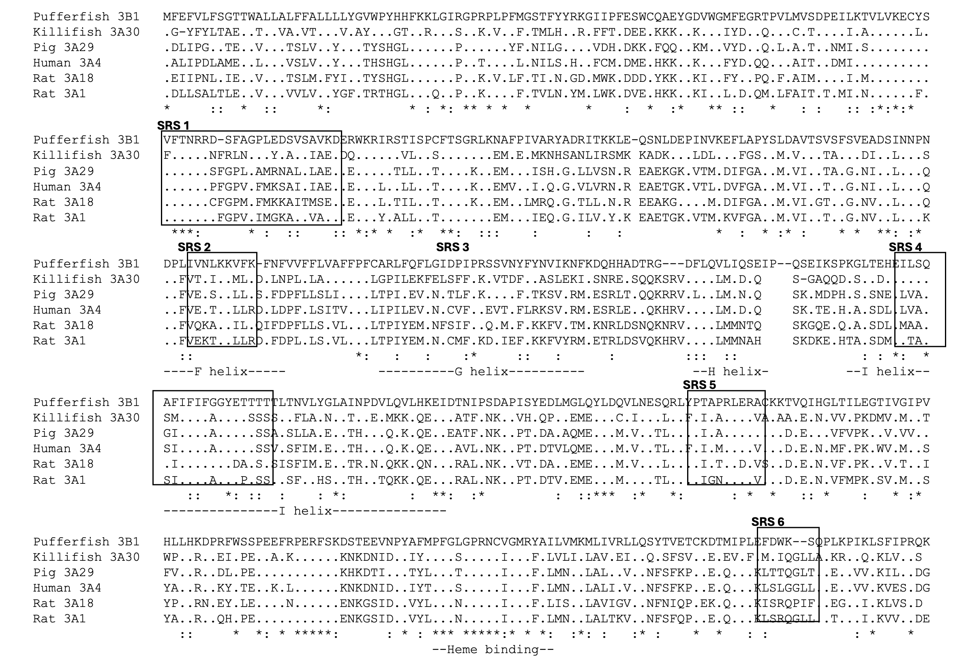
. = same amino acid, * = conservative change, : = semi-conservative change
- = gap; SRS = substrate recognition site

Slide 21
Multiple Sequence Alignment
Alignment involves appropriate substitution models
Alignment of divergent sequences may require structural constraints (e.g. rRNA folding) or special algorithms (e.g. MUSCLE)
Any alignment may have sub-sections that are poorly aligned and should be removed from phylogenetic analyses as HOMOLOGY is uncertain (i.e. not sure if all amino acids in the column reflect the same ancestral position in the protein).

Slide 22
Key Issues of Phylogenetics
1
How do we find homologous sites?
2
How do we model substitution?
3
How do we search for the best tree?

Slide 23
Key Issues of Phylogenetics
Modeling substitution and finding the best tree are intertwined in a concept called the “optimality criteria” – the philosophical / mathematical / computational framework you use to find the best (aka optimal) phylogenetic tree
2
How do we model substitution?
3
How do we search for the best tree?

Slide 24
Optimality Criteria
1
Parsimony
2
Distance Methods (e.g. Neighbour–joining)
3
Maximum Likelihood
4
Bayesian Inference

Slide 25
Optimality Criteria
2
Distance Methods (e.g. Neighbour–joining)
Simplify a multiple sequence alignment to a distance matrix
Loss of information; unreliable method
But it is very fast, so often used as a first-pass estimate
BEWARE publications with neighbour-joining trees!

Slide 26
Optimality Criteria
1
Parsimony
2
Distance Methods (e.g. Neighbour–joining)
3
Maximum Likelihood
4
Bayesian Inference

Slide 27
Optimality Criteria
1
Parsimony
A
A
?
A
?
A
C
G
Parsimony is Occam’s Razor, i.e. the simplest explanation is the easiest
Parsimony seeks to minimize the number of substitutions

Slide 28
Optimality Criteria
1
Parsimony
A
A
A
A
?
A
C
G
No changes required to explain the adenosines

Slide 29
Optimality Criteria
1
Parsimony
A
A
A
A
C
A
C
G
Score: Two changes

Slide 30
Optimality Criteria
1
Parsimony
A
A
A
A
A
A
C
G
Score: Two changes

Slide 31
Optimality Criteria
1
Parsimony
A
A
A
A
G
A
C
G
Score: Two changes

Slide 32
Optimality Criteria
1
Parsimony
A
A
A
A
T
A
C
G
Score: Three changes

Slide 33
Optimality Criteria
1
Parsimony
A
A
NO SUBSTITUTION MODEL!
3 of 4 possible bases are equally parsimonious!
LACK OF RESOLUTION!
A
A
C/G/A
A
C
G
Parsimony is fast since it only needs to count change but it deals poorly with multiple substitutions or unequal rates of evolution – it often lacks resolution

Slide 34
Optimality Criteria
1
Parsimony
2
Distance Methods (e.g. Neighbour–joining)
3
Maximum Likelihood
4
Bayesian Inference

Slide 35
Optimality Criteria
3
Maximum Likelihood

Slide 36
Optimality Criteria
3
Maximum Likelihood
A
A
?
A
?
A
C
G
Maximum likelihood (ML) does not apply Occam’s Razor
ML uses substitution models to better predict which changes have occurred
In ML, the length of the branches is as important as the shape of the tree

Slide 37
Optimality Criteria
3
Maximum Likelihood
A
A
A
A
?
A
C
G
No changes required to explain the adenosines

Slide 38
Optimality Criteria
3
Maximum Likelihood
A
A
A
A
A
A
C
G
A is the most likely as it is the shortest route

Slide 39
Optimality Criteria
3
Maximum Likelihood
A
A
A
A
A>c
A
C
G
C is the next most likely as it is the next shortest route

Slide 40
Optimality Criteria
3
Maximum Likelihood
A
A
A
A
A>c>g
A
C
G
G is the third most likely as it is the third shortest route

Slide 41
Optimality Criteria
3
Maximum Likelihood
BRANCH LENGTHS (e.g. shortest route) COME FROM A SUBSTITUTION MODEL
A SUBSTITUTION MODEL ADDS RESOLUTION!
A
A
A
A
A>c>g>t
A
C
G
Each possible solution has a likelihood and must be considered – ML is more complex, slower, but more accurate

Slide 42
Optimality Criteria
1
Parsimony
2
Distance Methods (e.g. Neighbour–joining)
3
Maximum Likelihood
4
Bayesian Inference – extension of ML

Slide 43
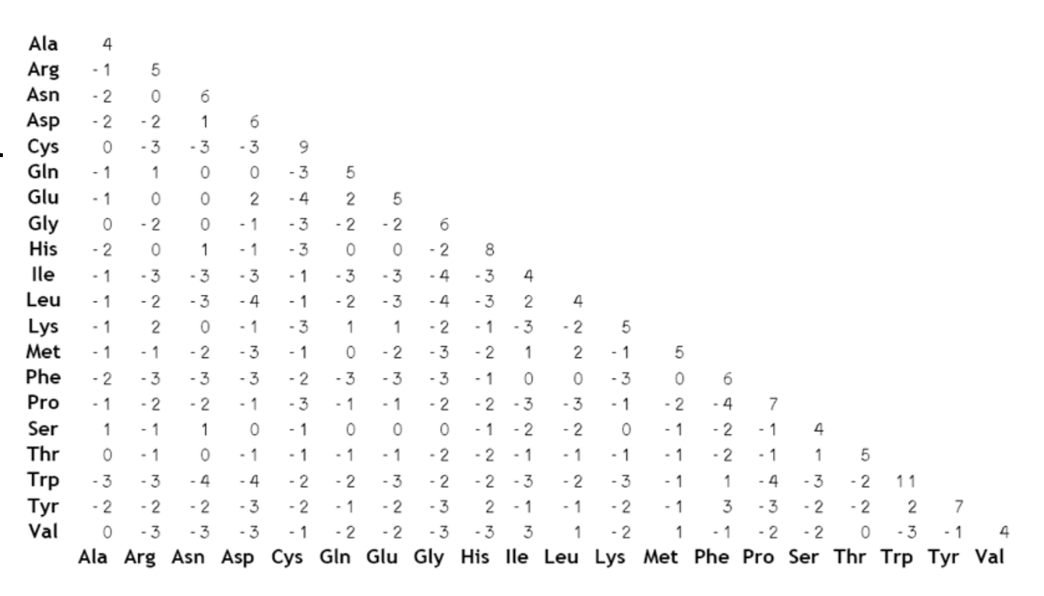
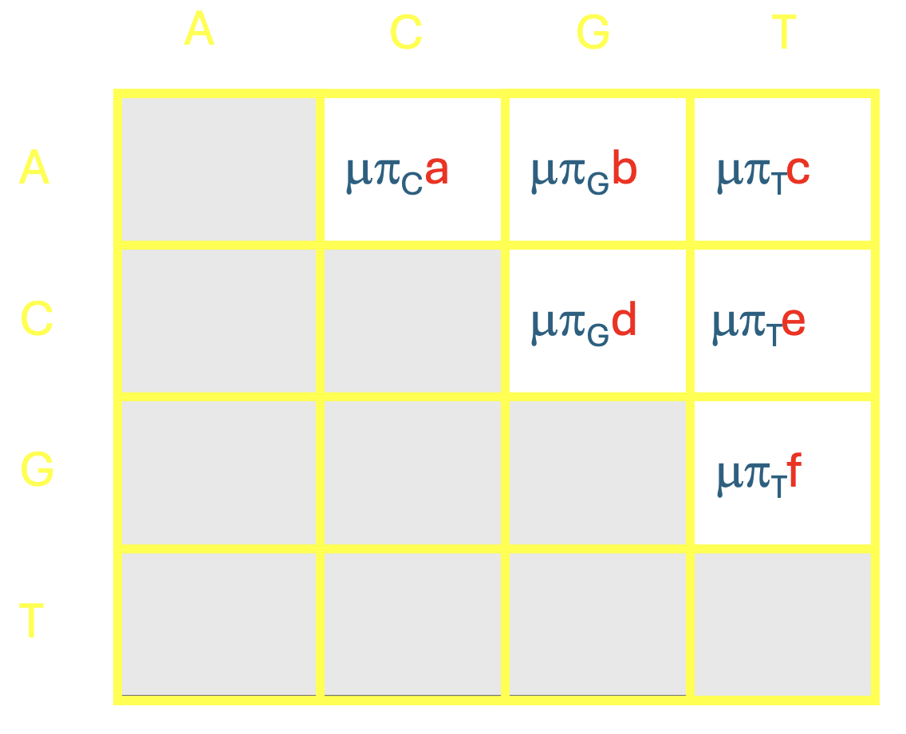
Substitution Models
Empirical
Theoretical
There are wide diversity of substitution models that can be used and you can design your own. Key aspects:
Unequal rates of substitution
Unequal amino acid / nucleotide frequencies

Slide 44
Key Issues of Phylogenetics
1
How do we find homologous sites?
2
How do we model substitution?
3
How do we search for the best tree?

Slide 45
Key Issues of Phylogenetics
The “best tree” is a function of the data (i.e. multiple sequence alignment) and substitution model.
bad alignment = bad tree
bad model = bad tree
3
How do we search for the best tree?

Slide 46
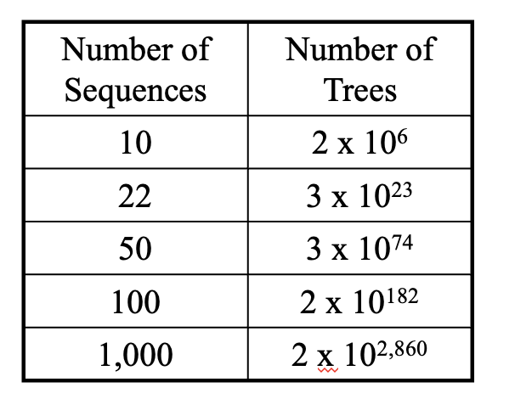
Key Issues of Phylogenetics
The “search space” in phylogenetics is huge! We cannot search all of it.
Yet we need to find the tree with the best “score”
Two tasks:
Scoring trees
Searching trees

Slide 47
Scoring a Single Tree
A
A
A
A
A>c>g>t
A
C
G
SCORE

Slide 48
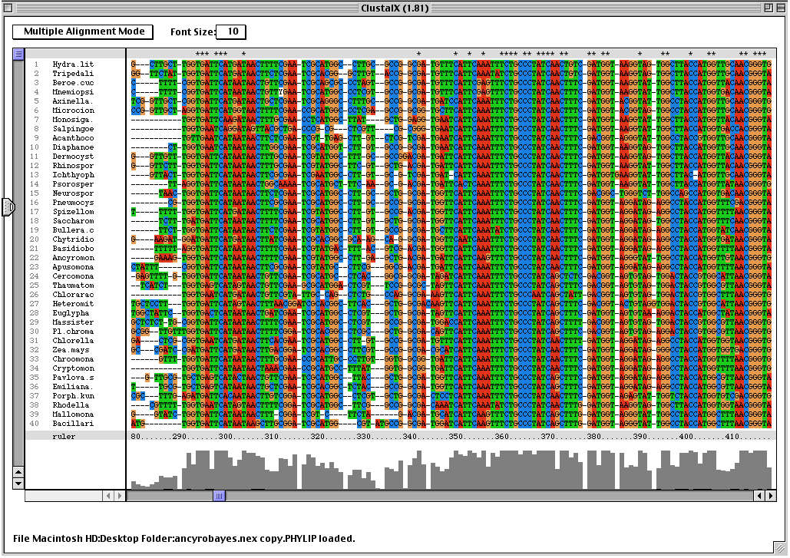
Scoring a Single Tree
A
A
A
A
A>c>g>t
A
C
G
SCORE
Each site (i.e. column) contributes to the score given the substitution model

Slide 49
Scoring a Single Tree
A
Among Site Rate Variation
A
A
Each site (i.e. column) does not contribute equally
A
A>c>g>t
A
C
G
SCORE
Each site (i.e. column) contributes to the score given the substitution model

Slide 50
Scoring requirements
1
A tree topology to score
Multiple sequence alignment
Substitution model
Unequal rates of substitution among amino acids or nucleotides
Unequal frequencies of amino acids or nucleotides
Incorporation of among-site rate variation
Recognize and model that different parts of a protein (e.g. binding site, globular domains, structural regions, functional domains) will evolve at different rates
Each column in the multiple sequence alignment thus has a faster or slower version of the substitution model
2
3
4

Slide 51
Caveats
Phylogenetic models generally work well even though they are an over-simplification
All methods assume neutrality or near-neutrality; positive selection is problematic
The methods break down when your data has extremes, e.g. fundamentally different rules of evolution in different parts of your protein

Slide 52
How do we find the best tree?
We can’t score them all. It would take far too long!
Instead, we use “tree space” search algorithms.

Slide 53
Finding the best tree
1
Parsimony
2
Distance Methods (e.g. Neighbour–joining)
3
Maximum Likelihood – branch swapping
4
Bayesian Inference – MC³, sample cloud of trees

Slide 54
Searching the ”Tree Space”: Branch swapping
Random starting tree
Best tree

Slide 55
Searching the ”Tree Space”: Branch swapping
Best tree

Slide 56
Searching the ”Tree Space”: Branch swapping
Branch swapping
Best tree

Slide 57
Searching the ”Tree Space”: Branch swapping
Best tree

Slide 58
Searching the ”Tree Space”: Branch swapping
Best tree

Slide 59
Searching the ”Tree Space”: Branch swapping
Best tree

Slide 60
Searching the ”Tree Space”: Branch swapping
Best tree

Slide 61
Searching the ”Tree Space”: Branch swapping
Best tree
Local optima

Slide 62
Searching the ”Tree Space”: Branch swapping
Best tree
Replicates! Each with a different random starting tree

Slide 63
Finding the best tree
1
Parsimony
2
Distance Methods (e.g. Neighbour–joining)
3
Maximum Likelihood – branch swapping
Never examine the majority of trees!
How many branch swapping replicates to avoid local optima?

Slide 64
Finding the best tree
1
Parsimony
2
Distance Methods (e.g. Neighbour–joining)
3
Maximum Likelihood – branch swapping
Never examine the majority of trees!
How many branch swapping replicates to avoid local optima?
What about confidence? Bootstrap!

Slide 65
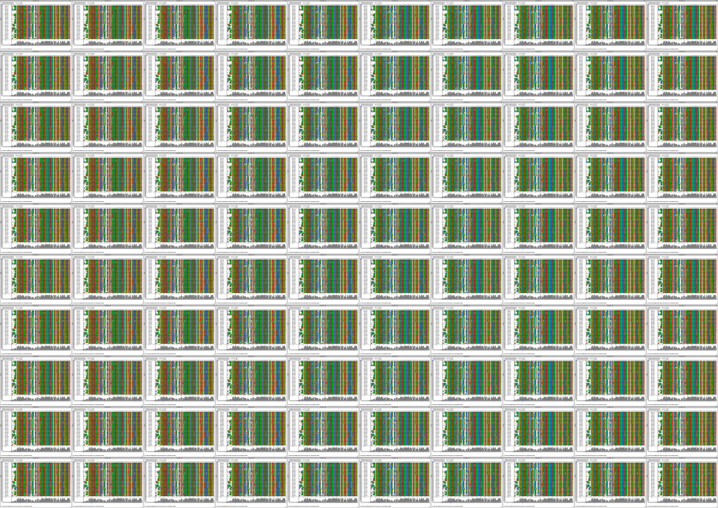
Maximum Likelihood & Bootstrapping
Resampling with replication
Branch swapping, with replication
Best Tree
Consensus tree with 100 bootstraps

Slide 66
Maximum Likelihood & Bootstrapping
Resampling with replication
Branch swapping, with replication
Best Tree
Computationally expensive!
Consensus tree with 100 bootstraps

Slide 67
RaxML
Fast tree space searching but local or sub-optima more likely
Stamatakis (2006). RAxML-VI-HPC: maximum likelihood-based phylogenetic analyses with thousands of taxa and mixed models.
Bioinformatics 22: 2688-2690.

Slide 68
Phylogenetics is not a black box method
Be skeptical of distance (NJ) and parsimony trees. Be aware of the assumptions and pitfalls
Questions to ask yourself when evaluating trees:
how good is the alignment?
  all sites homologous?
  poorly aligned regions removed?
how was the substitution model selected?
which optimality criteria is being used? why?
was the search of tree space robust?
was confidence properly assessed?
any known biases / extremes?

Slide 69

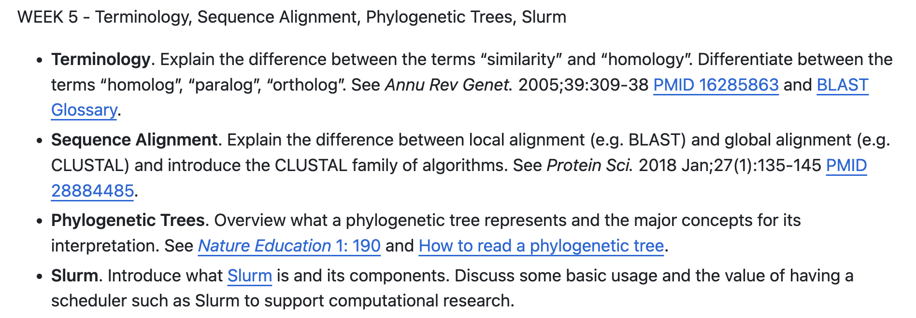
This week …

